Slide 1


Medchat : A Healthcare Chatbot
MENTORS
Mrs.Rupali Soni,Mrs.Sunita Sahu
Team Members | Class | Roll No
Khwaish Shahani | D12C | 56
Jaitra Shahani | D12C | 55
Karan Khatri | D12B | 22

Slide 2
Content
Introduction to the project
Problem Statement
Objectives of the project
Proposed System
Requirements of the system (Hardware, software)
Project Methodology
Front End
Implementation
Gantt Chart
Conclusion
References

Slide 3
Introduction to Project
The project focuses on creating a chatbot to be used by patients to get their queries responded easily by healthcare chatbot.
Chatbot is used extensively to check the health of disease any time.
The system is trained on comprehensive dataset 5000 to get better results.
Machine learning technique is primarily used to achieve precise prediction and boost the efficiency of the model.B.E.R.T. algorithm is used to provide more accurate and better results.
The system also provides disease description and detection.
The primary function is to provide health related queries
The system has been created as a web application.
Th Rates

Slide 4
Proposed System
This project aims to build a healthcare chatbot system using web technology and machine learning for the graphical interface and SQLite for database management
User Interface: Html,Css,Javascript will be used to create a user-friendly interface with features like user profile management, food search, personalized recommendations, and feedback submission.
Database Schema: SQLite will manage the database, storing user profiles, food items, preferences, and feedback. Tables include Users, medicines, Preferences, and Feedback.
Recommendations Algorithm: The system will employ content-based filtering, analyzing user preferences, historical data, and medicinal attributes to generate personalized recommendations based on factors like category, nutritional value, and user feedback.

Slide 5
Proposed System of Project
The proposed system consists of a user-friendly chat interface through which a user can communicate with the system
The user can either enter symptoms which he is experiencing or enter some health-related queries. Depending on the user input, the chatbot will predict the disease or provide relevant information about his queries.
The system has pre-processed the disease dataset, converting the categorical values into a suitable structured numerical dataset for training of the Natural language processing model.
The system has trained and compared one Natural language processing models B.E.R.T.
Rates

Slide 6
Proposed System of the project
r Rates
.
User Login into the system and register on the chatbot system:
Then ask queries regarding to the health care and medical details Ask some Questions You can ask some questions regarding some healthcare. And its related to voice- text and text-voice conversation. Using Google API for inter conversion of text-voice and vice versa.
Age based medical details:
You can ask medical dosage related queries to this app in voice and system gets output for medicine API and speak out and display all data. Get your age from registration data and provide data related to your data like age, area, gender and so on. Give me age Then predict disease using Bert Algorithm.
Disease Prediction Depending on disease system
B.E.R.T. algorithm can predict the disease.

Slide 7
Requirements of the system
(Hardware, software)
Hardware Ram : At least 4GB Diskspace : 2GB Processor : Minimum intel i3 generation or above Laptop,Pc | Software Intellij IDEA Git and Github Mysql Language : Html,Css,Javascript

Slide 8
Proposed Methodology
Machine Learning Model:
Develop a smart machine learning model.
Predicts the likelihood of an patient’s diseases.
Specialized Chatbot Website:
Create a dedicated website application for athletes.
Designed to assist patients in case of minor injuries.
Provides a fast and efficient way to locate the nearest hospital with expertise in treating major/serious diseases.
Objectives:
Enhance healthcare chatbot safety by predicting potential injuries.
Facilitate quick access to medical assistance and suitable treatment for patients.
Contribute to overall patients well-being.
Rates

Slide 9
Proposed Methodology
To predict patients disease and recommend nearby medical facilities, steps are :
Collect historical diseases and relevant data.
Clean and preprocess the data, then engineer features.
Develop a machine learning model and validate it.
Use this model to predict the likelihood of diseases .
Integrate geographical data to identify the nearest medical facilities.
Continuously update and improve the system while addressing ethical concerns.
Design a user-friendly interface for data input and information access.
Thoroughly test and validate the system.

Slide 10
Literature Survey
Title | Author | Date | Feature | Drawback
Chatbots emeet Health:automizing ehealthcare [1] | Flora Amato, Vincezo Gabriele | 2017 | In this recommendation system has been recent advance of technologies for data processing and analytics have radically changed the healthcare solutions,promising to become more efficient,less expensive and higher quality | Limited to social network data for

Slide 11
Literature Survey
Title | Author | Date | Feature | Drawback
Textbased healthcare chatbots Supporting Patient and Health Professional teams[3] | University of St.Gallen, Institute of Technology management,St.Gallen Switzerland | 2016 | Technology based self service channels and digital interventions have potential to support patients in everyday life and healthcare professionals.Although there are scalable self service channels in form of digital voice assistants and chatbots offeredApple(Siri),Amazon(Alexa),Google(Assistent), Microsoft(Cortana) or Samsung (Bixby) they cannot be applied in healthcare. | Limited to social network data for recommendation
Preparation of Rasberry Pi for IOT enabled applications[4] | Devraj Manoj | 2018 | The VAs and natural language processing tools such as text to voice conversation libraries are also useful for automation of the sophisticated software developments .The text to speech conversion API is useful for visually impaired person.The Siri,Alexa ,Google Now,Cortana are few examples of VA.The Rootbot is a personal shopping assistant | Relies heavily on user input for customization

Slide 12
Literature Survey
Title | Author | Date | Feature | Drawback
Chatbots with Machine Learning:Building Neural Conversations Agent[5] | Luba Belokon | 2015 | There are two major types of dialogue system.:goal oriented (i.e. Siri,Alexa,Cortana)etc..The former people help to solve everyday problems using natural language,latter attemp to talk with people using wide range of topics. | Limited to social network data for
Chatbot for Hospital Management system[6] | Srinivasa Rao Dammanavalam Candana Nukala Rajeshwari rao Lahari anegama Manish kumar Ravikant | 2023 | The proposed system integrates basic features in an application and adds AI chatbot for easy navigation, doctor data, diagnostics, symptom analysis, and appointment booking. It accepts both voice and text input. The website is built using Flask with login, dashboard, appointment, and chatbot button. Speech-enabled chatbots provide high interactivity with text or voice input/output. Speech to text is achieved using Google's Web Speech API, and text to speech is done using pyttsx3. User queries are analyzed using an LSTM model with forget, remember, learn, and output gates. A sequential model with 3 layers and SGD optimization is used, achieving 94.85% accuracy and 8.15% loss with 1000 epochs. | Enabling Speech recognition in our chatbot also helps customers to have a simple and fast conversation

Slide 13
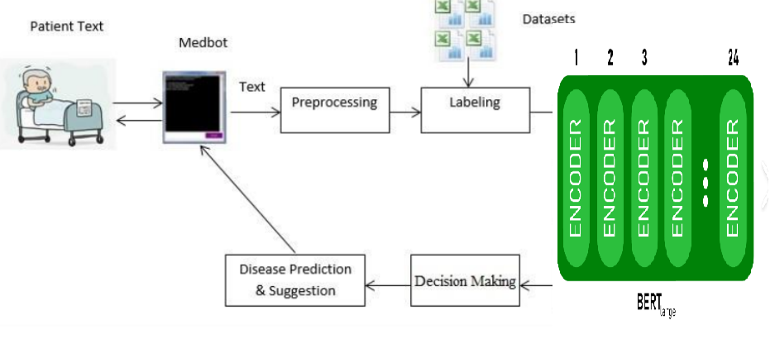
Block diagram of chatbot

Slide 14
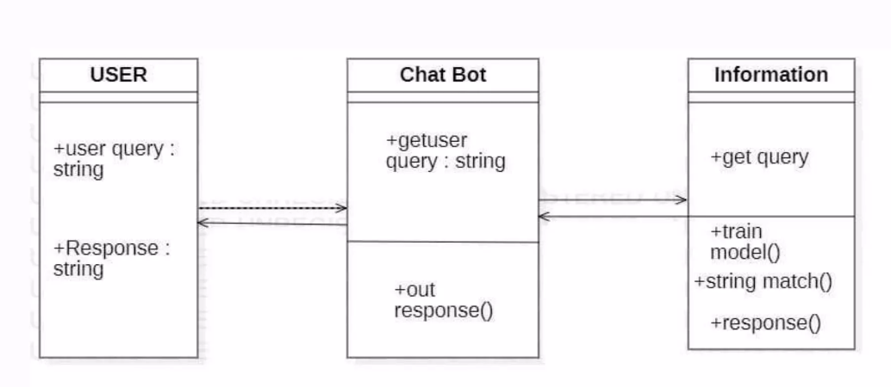
Class diagram of chatbot

Slide 15
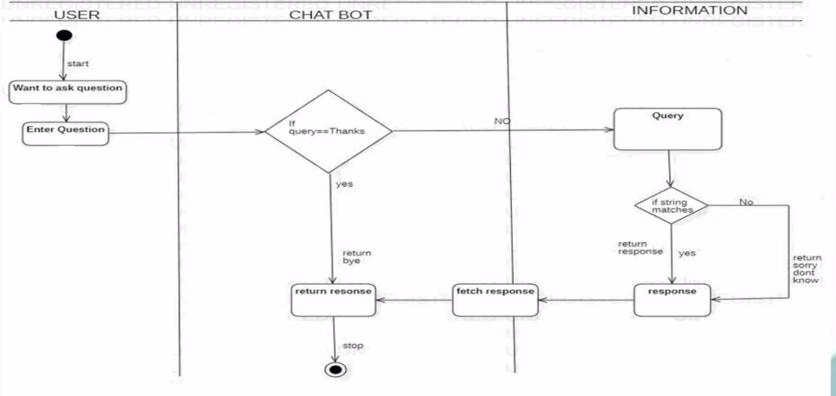
Activity diagram of chatbot

Slide 16
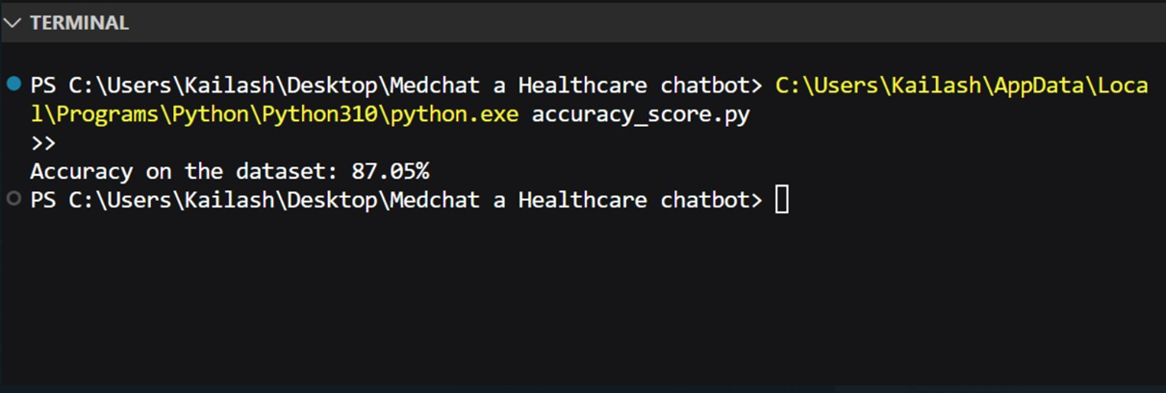
Implementation
BERT Model Accuracy on the Dataset

Slide 17
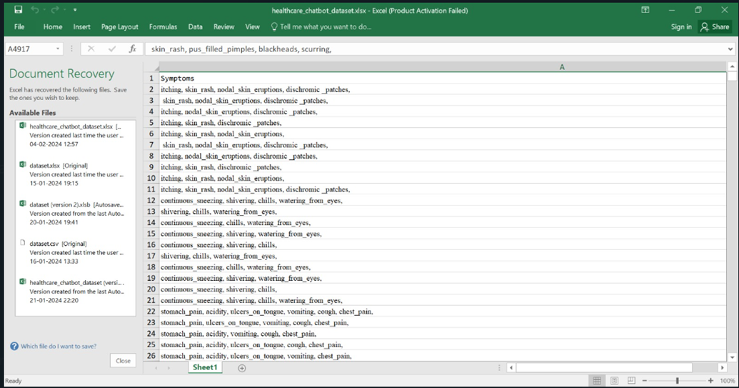
Implementation
Dataset used for training a BERT Model

Slide 18
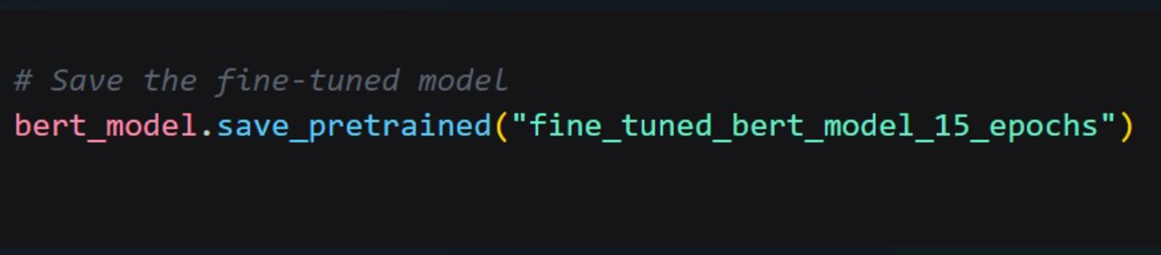
Implementation
Saving The Model
After Fine Tuning(Training the BERT Model on the Dataset ) It Iterated 15 Epochs and Got Saved in the Directory By This Folder Name that is "fine_tuned_bert_model_15_epochs"

Slide 19
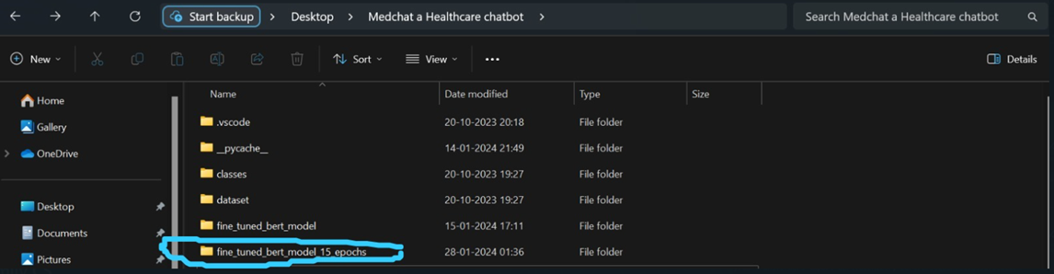
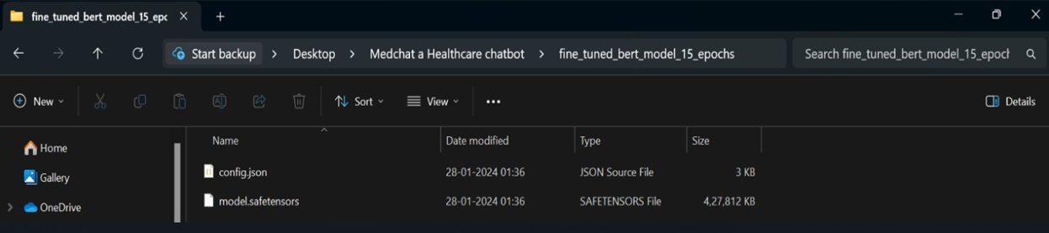
Implementation
Got Saved In the Directory by this Folder Name

Slide 20
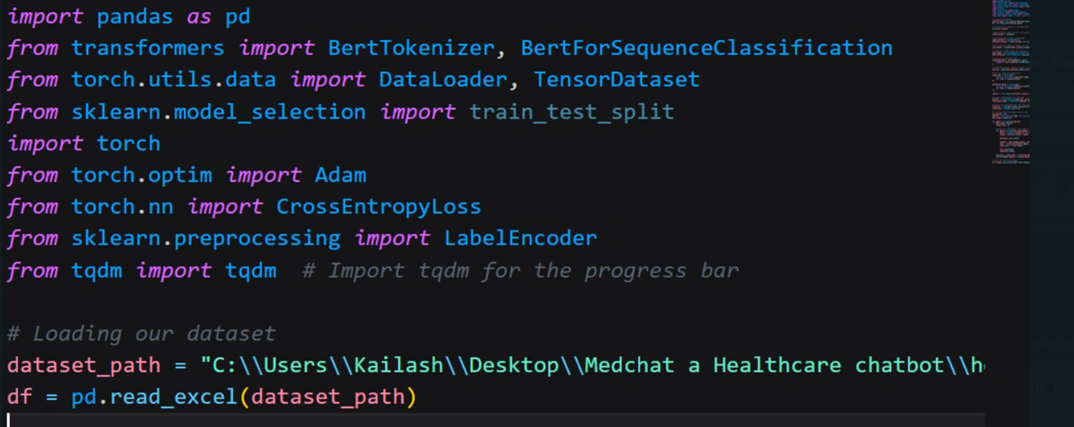
Implementation
Defining the dataset path for the sample Testing After training

Slide 21
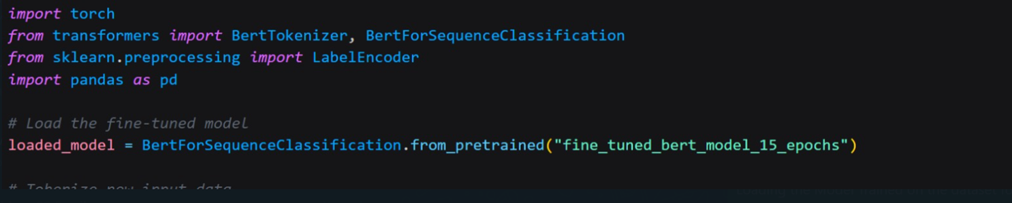
Implementation
Loading The Model Trained on the dataset for making predictions

Slide 22
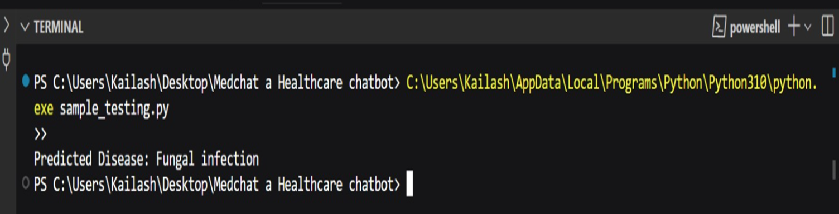
Implementation
Predicting the Disease Immediately after Providing the Symptom

Slide 23
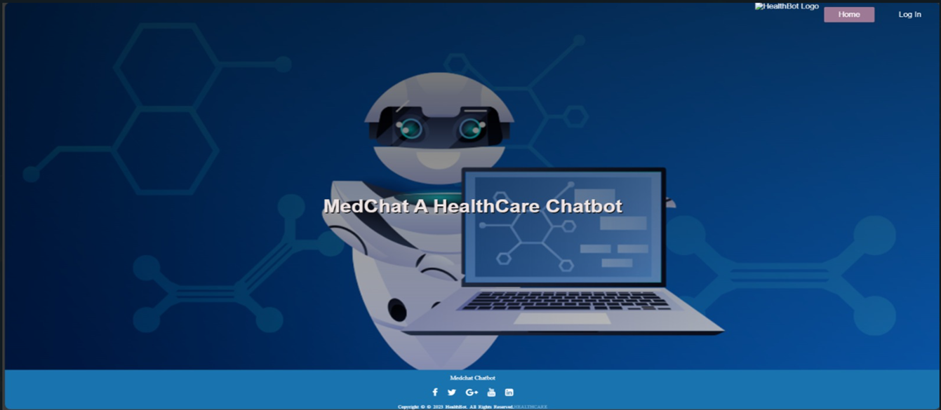
Implementation
Home Page

Slide 24
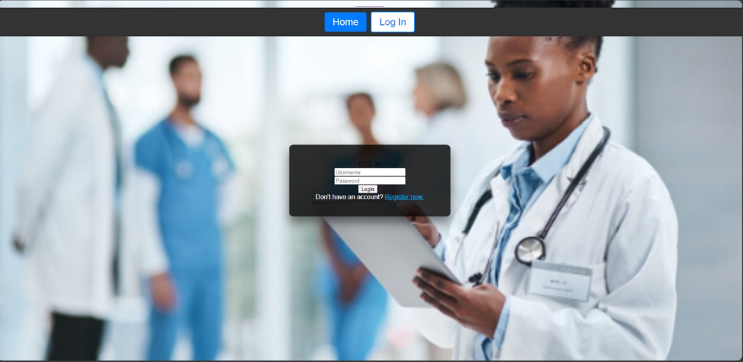
Implementation
Login Page

Slide 25
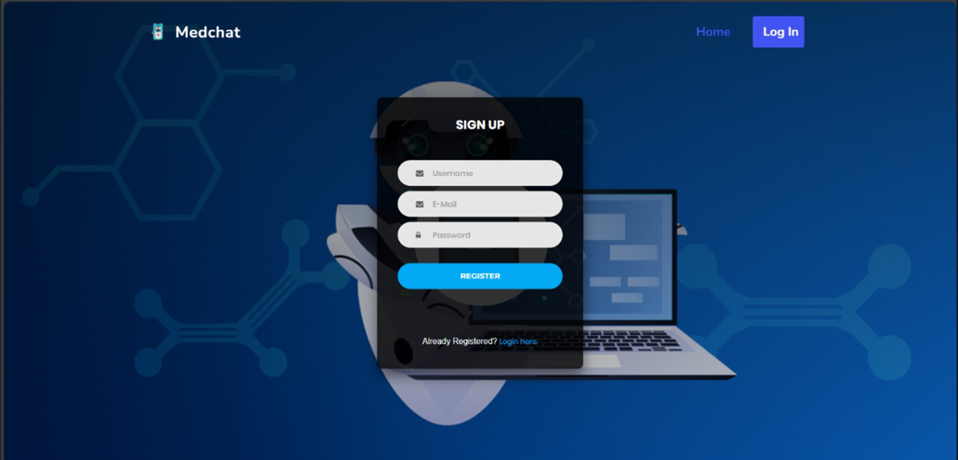
Implementation
Register Page

Slide 26
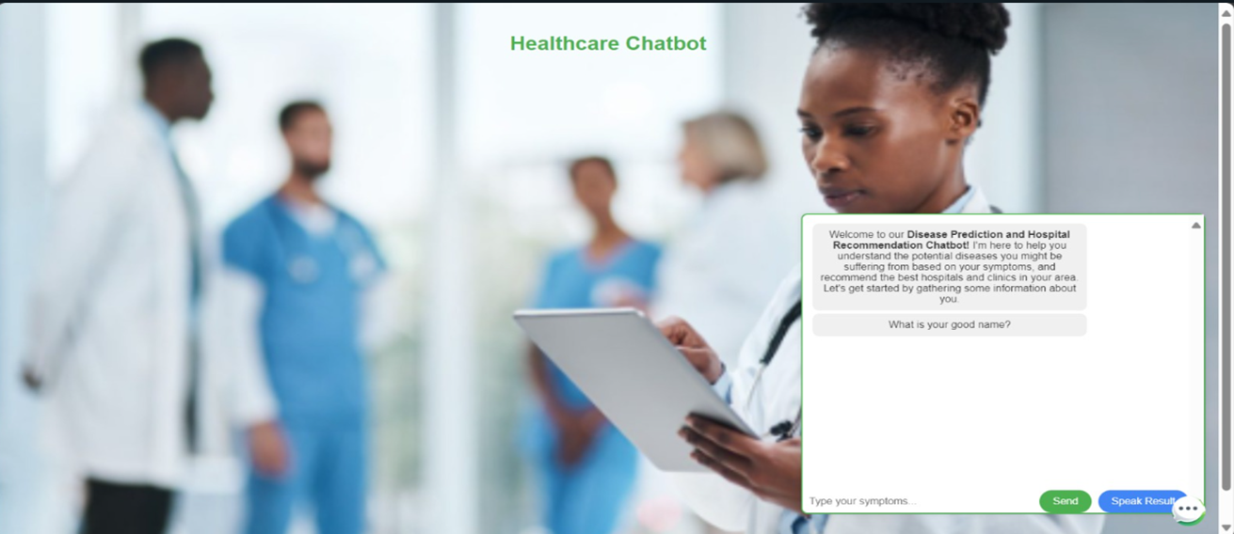
Implementation
Main Chatbot page

Slide 27
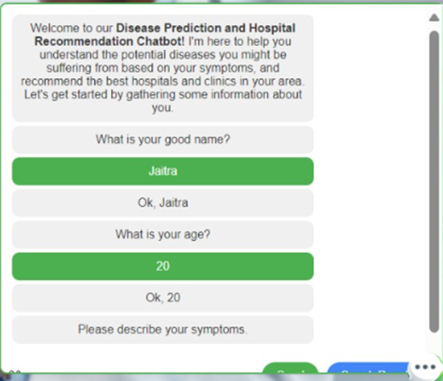
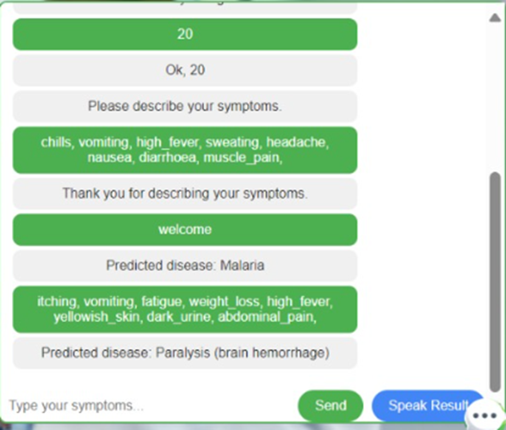
Implementation
Main Chatbot page

Slide 28
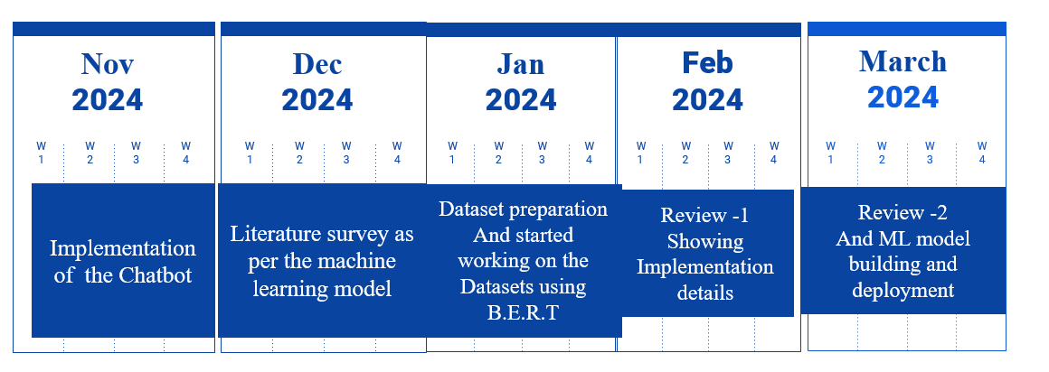
Gantt Chart
Notes:
The max flow algorithm in the visualization is :-

Slide 29
Conclusion
A B.E.R.T model has been implemented as part of the solution.
The model achieved an accuracy score of 87%..
The main objective of our chatbot is to automate repeated tasks in a user-friendly manner such that it will provide hospital employees to focus on important tasks and also to enable fast response for customer instead of waiting for employee to solve their queries as user can interact with bot anytime.
The user interactive UI provides better navigation through the website.

Slide 30
Future Work
By taking the advantage of the extensibility of the system in future it will be used as voice and face recognition to mimic a counselor, also interacting with the patient at deeper levels.
Enabling Speech recognition in our chatbot also helps customers to have a simple and fast conversation.
There can always be a scope of improvement for any project.
In this we can incorporate more department specific data to make the chatbot more diverse, as of now disease diagnosis, appointment booking, viewing user appointment details and test costs are included.
More refined data will give more scope for user to resolve their queries.
The application can be integrated with any hospital website to make it more reachable for users.
Enabling voice recognition technology for users who prefer to submit diseases via voice commands or recordings would be beneficial.

Slide 31

Thanks
Do you have any questions?
2021.khwaish.shahani@ves.ac.in
2021.jaitra.shahani@ves.ac.in
+91 9594678912

Slide 32
References

